Slide 1
PHP MySQL Database

Slide 2
PHP MySQL Introduction
What is MySQL: MySQL is one of the most popular relational database system being used on the Web today. It is freely available and easy to install, however if you have installed Wampserver it already there on your machine. MySQL database server offers several advantages:
MySQL is easy to use, yet extremely powerful, fast, secure, and scalable.
MySQL runs on a wide range of operating systems, including UNIX or Linux, Microsoft Windows, Apple Mac OS X, and others.
MySQL supports standard SQL (Structured Query Language).
MySQL is ideal database solution for both small and large applications.
MySQL is developed, and distributed by Oracle Corporation.
MySQL includes data security layers that protect sensitive data from intruders.
MySQL database stores data into tables like other relational database. A table is a collection of related data, and it is divided into rows and columns.

Slide 3
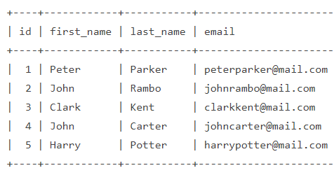
Structure of a simple MySQL table
Each row in a table represents a data record that are inherently connected to each other such as information related to a particular person, whereas each column represents a specific field such as id, first_name, last_name, email, etc.

Slide 4
Talking to MySQL Databases with SQL
SQL, the Structured Query Language, is a simple, standardized language for communicating with relational databases like MySQL. With SQL you can perform any database-related task, such as creating databases and tables, saving data in database tables, query a database for specific records, deleting and updating data in databases.
Look at the following standard SQL query that returns the email address of a person whose first name is equal to 'Peter' in the persons table: SELECT email FROM persons WHERE first_name="Peter"

Slide 5
PHP Connect to MySQL Server
Ways of Connecting to MySQL through PHP: In order to store or access the data inside a MySQL database, you first need to connect to the MySQL database server. PHP offers two different ways to connect to MySQL server: MySQLi (Improved MySQL) and PDO (PHP Data Objects) extensions.
While the PDO extension is more portable and supports more than twelve different databases, MySQLi extension as the name suggests supports MySQL database only. MySQLi extension however provides an easier way to connect to, and execute queries on, a MySQL database server. Both PDO and MySQLi offer an object-oriented API, but MySQLi also offers a procedural API which is relatively easy for beginners to understand.

Slide 6
Connecting to MySQL Database Server
In PHP you can easily do this using the mysqli_connect() function. All communication between PHP and the MySQL database server takes place through this connection. Here're the basic syntaxes for connecting to MySQL using MySQLi and PDO extensions:
Syntax: MySQLi, Procedural way: $link = mysqli_connect("hostname", "username", "password", "database");
Syntax: MySQLi, Object Oriented way: $mysqli = new mysqli("hostname", "username", "password", "database");
Syntax: PHP Data Objects (PDO) way: $pdo = new PDO("mysql:host=hostname;dbname=database", "username", "password");

Slide 7
Continue..
The hostname parameter in the syntax specify the host name (e.g. localhost), or IP address of the MySQL server, whereas the username and password parameters specifies the credentials to access MySQL server, and the database parameter, if provided will specify the default MySQL database to be used when performing queries.

Slide 8
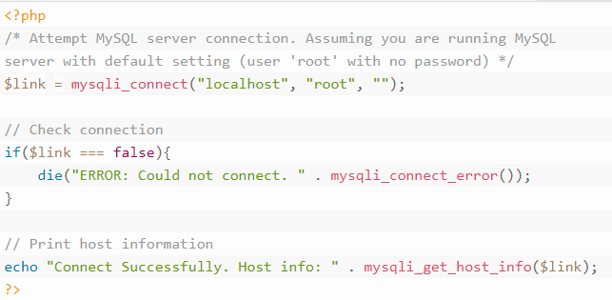
Example: Procedural

Slide 9
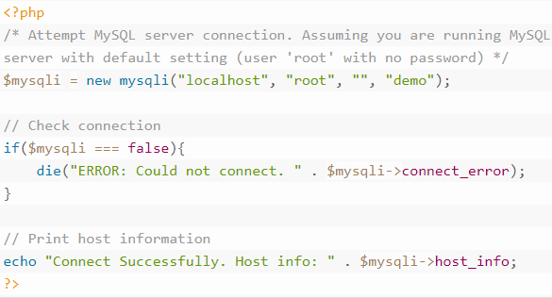
Example: Object Oriented

Slide 10
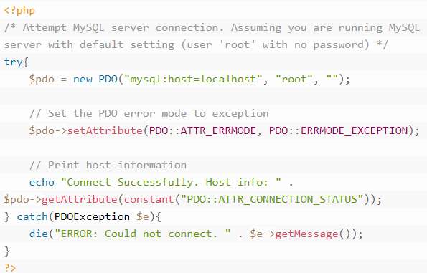
Example: PHP Data Object

Slide 11
Closing the MySQL Database Server Connection
The connection to the MySQL database server will be closed automatically as soon as the execution of the script ends. However, if you want to close it earlier you can do this by simply calling the PHP mysqli_close() function.

Slide 12
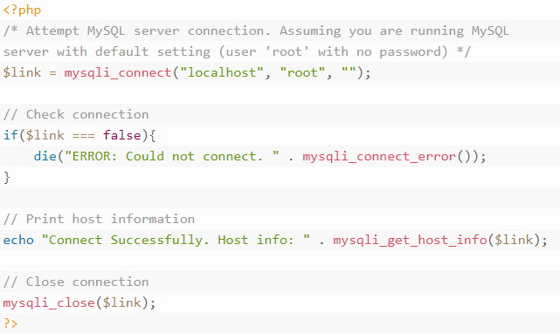
Example: Procedural

Slide 13
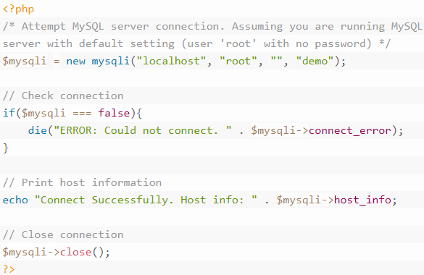
Example: Object Oriented

Slide 14
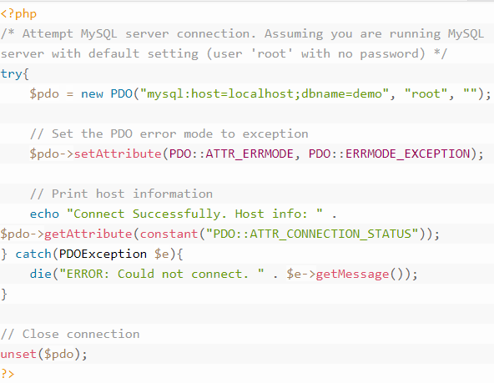
Example: PHP Data Object (PDO)

Slide 15
PHP MySQL Create Database
Creating MySQL Database Using PHP: Now that you've understood how to open a connection to the MySQL database server.
Before saving or accessing the data, we need to create a database first. The CREATE DATABASE statement is used to create a new database in MySQL.
Let's make a SQL query using the CREATE DATABASE statement, after that we will execute this SQL query through passing it to the PHP mysqli_query() function to finally create our database.

Slide 16
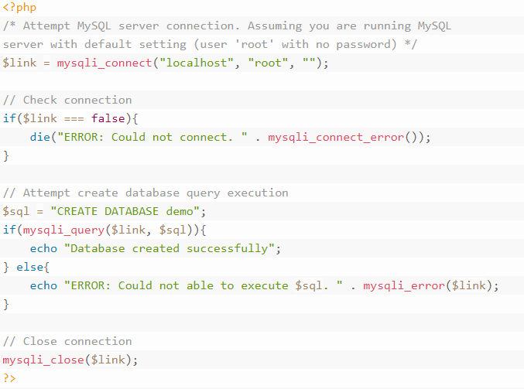
Example: Procedural

Slide 17
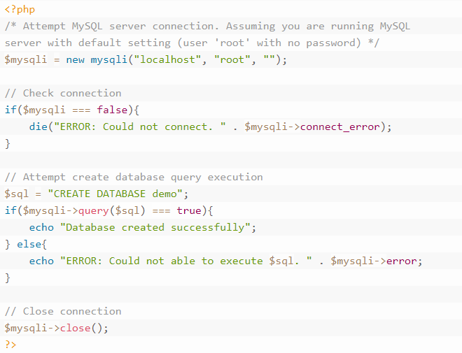
Example: Object Oriented

Slide 18
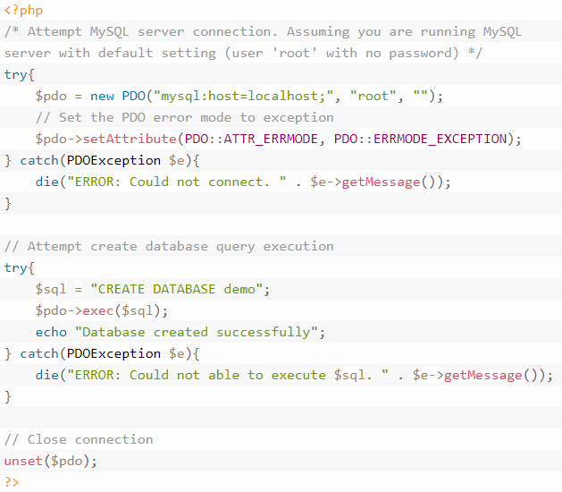
Example: PDO

Slide 19
PHP MySQL Create Tables
Creating Tables inside MySQL Database Using PHP: Now it's time to create some tables inside the database that will actually hold the data. A table organizes the information into rows and columns.
The SQL CREATE TABLE statement is used to create a table in database.
Let's make a SQL query using the CREATE TABLE statement, after that we will execute this SQL query through passing it to the PHP mysqli_query() function to finally create our table.

Slide 20
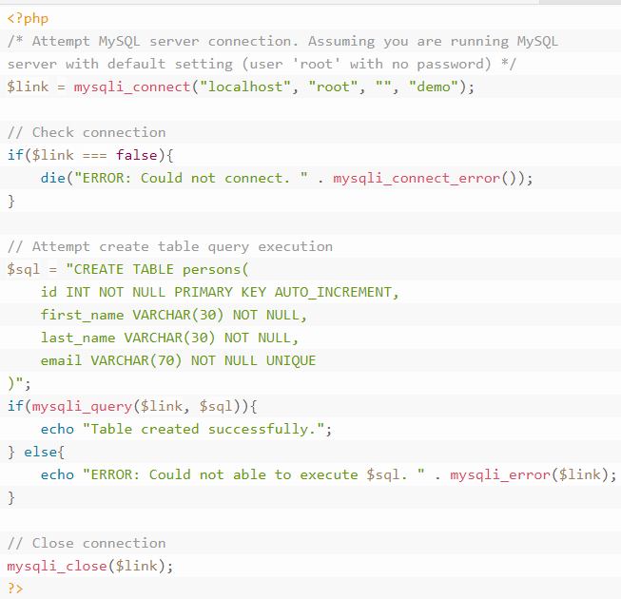
Example: Procedural

Slide 21
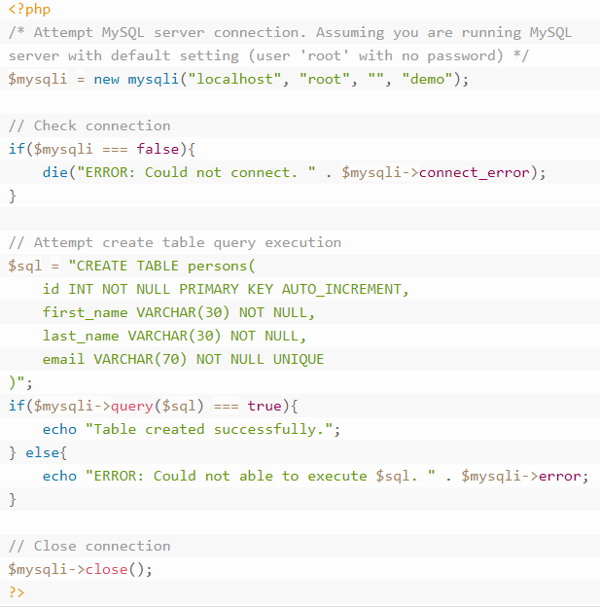
Example: Object Oriented

Slide 22
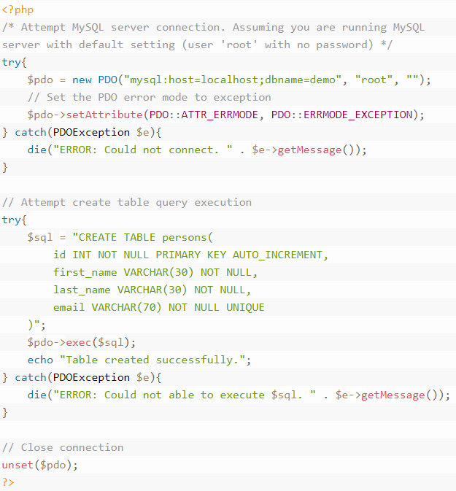
Example: PDO

Slide 23
PHP MySQL INSERT Query
Inserting Data into a MySQL Database Table: Now that you've understood how to create database and tables in MySQL. Here you will learn how to execute SQL query to insert records into a table.
The INSERT INTO statement is used to insert new rows in a database table.
Let's make a SQL query using the INSERT INTO statement with appropriate values, after that we will execute this insert query through passing it to the PHP mysqli_query() function to insert data in table. Here's an example, which insert a new row to the persons table by specifying values for the first_name, last_name and email fields.

Slide 24
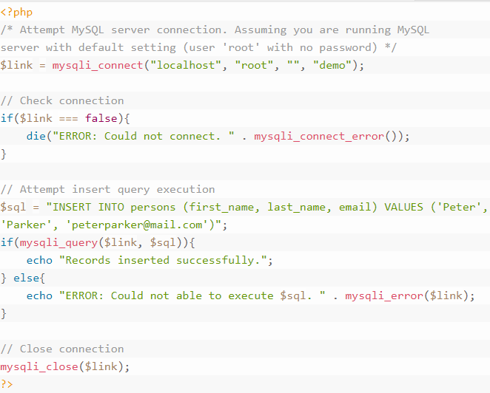
Example: Procedural

Slide 25
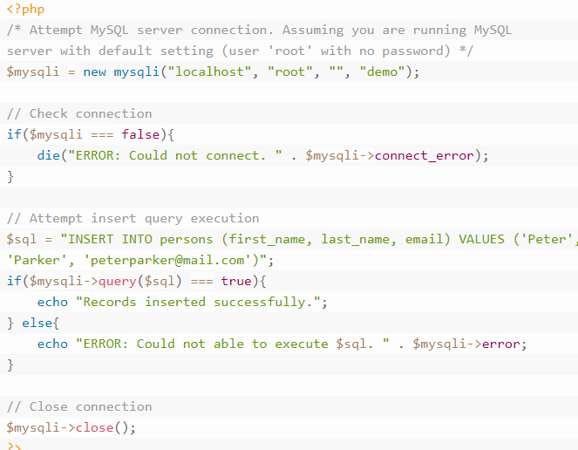
Example: Object Oriented

Slide 26
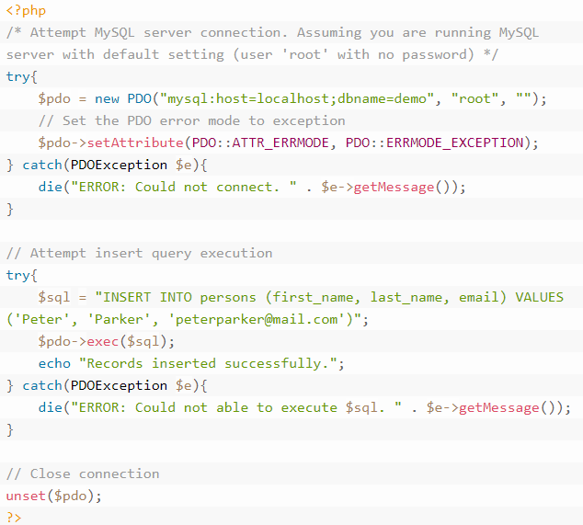
Example: PDO

Slide 27
Inserting Multiple Rows into a Table
You can also insert multiple rows into a table with a single insert query at once. To do this, include multiple lists of column values within the INSERT INTO statement, where column values for each row must be enclosed within parentheses and separated by a comma.

Slide 28
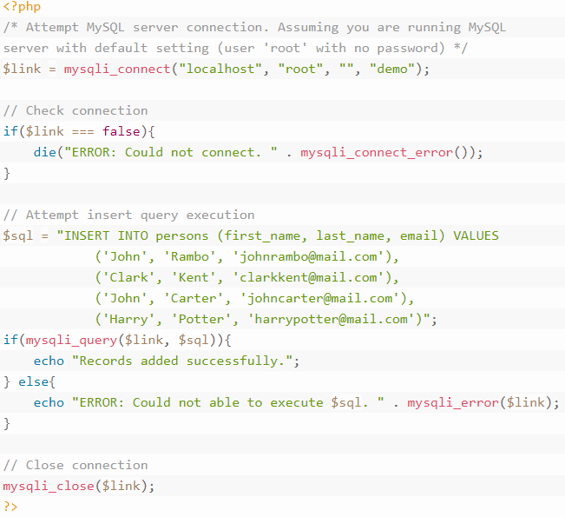
Example

Slide 29
Insert Data into a Database from an HTML Form
Now, we'll see how we can insert data into database obtained from an HTML form. Let's create an HTML form that can be used to insert new records to persons table.
Step 1: Creating the HTML Form
Step 2: Retrieving and Inserting the Form Data
Continue..

Slide 30
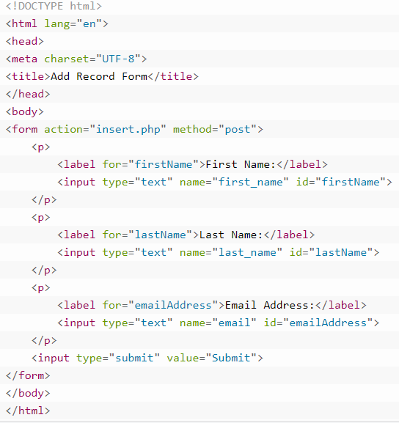
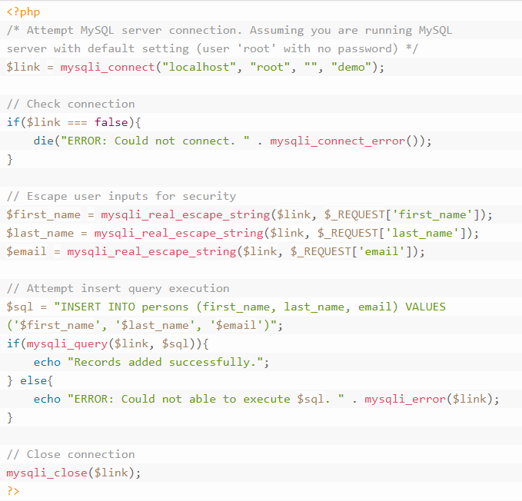

Slide 31
PHP MySQL Prepared Statements
What is Prepared Statement: A prepared statement (also known as parameterized statement) is simply a SQL query template containing placeholder instead of the actual parameter values. These placeholders will be replaced by the actual values at the time of execution of the statement.
MySQLi supports the use of anonymous positional placeholder (?), as shown below:
INSERT INTO persons (first_name, last_name, email) VALUES (?, ?, ?);
While, PDO supports both anonymous positional placeholder (?), as well as the named placeholders. A named placeholder begins with a colon (:) followed by an identifier, like this:
INSERT INTO persons (first_name, last_name, email)
VALUES (:first_name, :last_name, :email);

Slide 32
Stages of Prepared
The prepared statement execution consists of two stages: prepare and execute.
Prepare — At the prepare stage a SQL statement template is created and sent to the database server. The server parses the statement template, performs a syntax check and query optimization, and stores it for later use.
Execute — During execute the parameter values are sent to the server. The server creates a statement from the statement template and these values to execute it.
Prepared statements is very useful, particularly in situations when you execute a particular statement multiple times with different values, for example, a series of INSERT statements. The following section describes some of the major benefits of using it.

Slide 33
Advantages of Using Prepared Statements
A prepared statement can execute the same statement repeatedly with high efficiency, because the statement is parsed only once again, while it can be executed multiple times.
It also minimize bandwidth usage, since upon every execution only the placeholder values need to be transmitted to the database server instead of the complete SQL statement.
Prepared statements also provide strong protection against SQL injection, because parameter values are not embedded directly inside the SQL query string.
The parameter values are sent to the database server separately from the query using a different protocol and thus cannot interfere with it.
The server uses these values directly at the point of execution, after the statement template is parsed. That's why the prepared statements are less error-prone, and thus considered as one of the most critical element in database security.

Slide 34
PHP MySQL Last Inserted ID
How to Get the ID of Last Inserted Row: In the PHP MySQL insert chapter you've learnt MySQL automatically generate an unique ID for the AUTO_INCREMENT column each time you insert a new record or row into the table. However, there are certain situations when you need that automatically generated ID to insert it into a second table. In these situations you can use the PHP mysqli_insert_id() function to retrieve the most recently generated ID, as shown in the upcoming example.
For this example we'll use the same persons table that we've created in the PHP MySQL create tables chapter, which has four columns id, first_name, last_name and email, where id is the primary key column and marked with AUTO_INCREMENT flag.

Slide 35
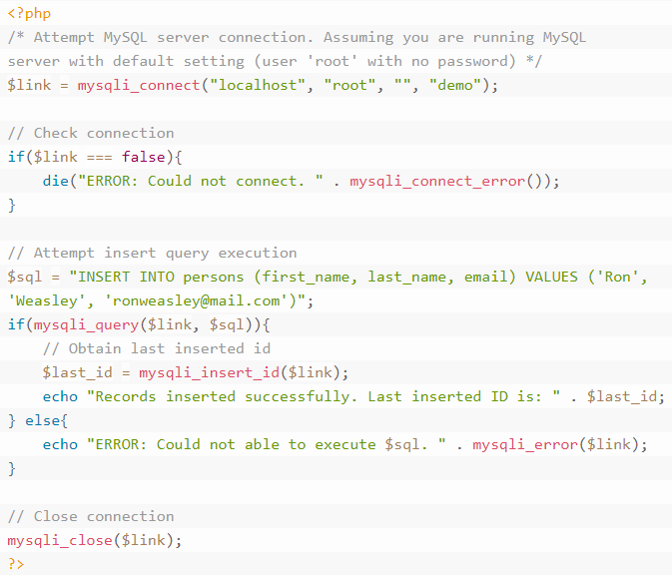
Example

Slide 36
PHP MySQL SELECT Query
Selecting Data From Database Tables: The SQL SELECT statement is used to select the records from database tables. Its basic syntax is as follows:
SELECT column1_name, column2_name, columnN_name FROM table_name;
Let's make a SQL query using the SELECT statement, after that we will execute this SQL query through passing it to the PHP mysqli_query() function to retrieve the table data.

Slide 37
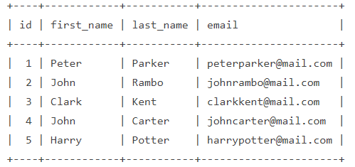
Continue..
Consider our persons database table has the following records:

Slide 38
PHP MySQL WHERE Clause
Filtering the Records
The WHERE clause is used to extract only those records that fulfill a specified condition.
The basic syntax of the WHERE clause can be given with:
SELECT column_name(s) FROM table_name WHERE column_name operator value

Slide 39
PHP MySQL LIMIT Clause
Limiting Result Sets: The LIMIT clause is used to constrain the number of rows returned by the SELECT statement. This feature is very helpful for optimizing the page loading time as well as to enhance the readability of a website. For example you can divide the large number of records in multiple pages using pagination, where limited number of records will be loaded on every page from the database when a user request for that page by clicking on pagination link.
The basic syntax of the LIMIT clause can be given with:
SELECT column_name(s) FROM table_name LIMIT row_offset, row_count;

Slide 40
Continue..
The LIMIT clause accepts one or two parameters which must be a nonnegative integer:
When two parameters are specified, the first parameter specifies the offset of the first row to return i.e. the starting point, whereas the second parameter specifies the number of rows to return. The offset of the first row is 0 (not 1).
Whereas, when only one parameter is given, it specifies the maximum number of rows to return from the beginning of the result set.
For example, to retrieve the first three rows, you can use the following query:
SELECT * FROM persons LIMIT 3;
To retrieve the rows 2-4 (inclusive) of a result set, you can use the following query:
SELECT * FROM persons LIMIT 1, 3;

Slide 41
PHP MySQL ORDER BY Clause
Ordering the Result Set: The ORDER BY clause can be used in conjugation with the SELECT statement to see the data from a table ordered by a specific field. The ORDER BY clause lets you define the field name to sort against and the sort direction either ascending or descending.
The basic syntax of this clause can be given with:
SELECT column_name(s) FROM table_name ORDER BY column_name(s) ASC|DESC

Slide 42
PHP MySQL UPDATE Query
Updating Database Table Data: The UPDATE statement is used to change or modify the existing records in a database table. This statement is typically used in conjugation with the WHERE clause to apply the changes to only those records that matches specific criteria.
The basic syntax of the UPDATE statement can be given with:
UPDATE table_name SET column1=value, column2=value2,... WHERE column_name=some_value

Slide 43
PHP MySQL DELETE Query
Deleting Database Table Data: Just as you insert records into tables, you can delete records from a table using the SQL DELETE statement. It is typically used in conjugation with the WHERE clause to delete only those records that matches specific criteria or condition.
The basic syntax of the DELETE statement can be given with:
DELETE FROM table_name WHERE column_name=some_value

Slide 44
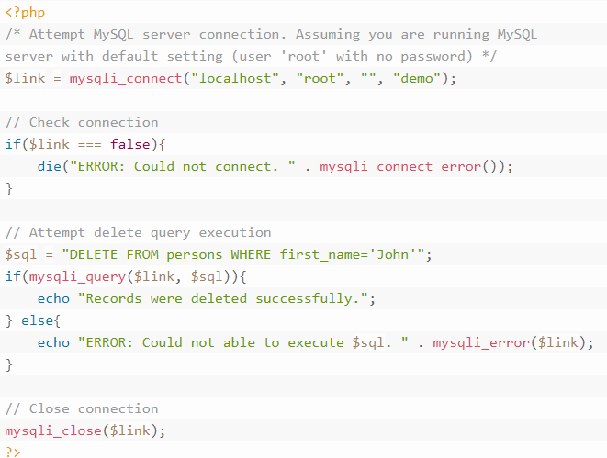
Example

Slide 45
PHP MySQL CRUD Application
What is CRUD: CRUD is an acronym for Create, Read, Update, and Delete. CRUD operations are basic data manipulation for database. We've already learned how to perform create (i.e. insert), read (i.e. select), update and delete operations in previous slides.

Slide 46
PHP MySQL Ajax Live Search
Ajax Live Database Search
You can create a simple live database search functionality utilizing the Ajax and PHP, where the search results will be displayed as you start typing some character in search input box.
In this tutorial we're going to create a live search box that will search the countries table and show the results asynchronously. But, first of all we need to create this table.

Slide 47
Step 1: Creating the Database Table
CREATE TABLE countries (
id INT NOT NULL PRIMARY KEY AUTO_INCREMENT,
name VARCHAR(50) NOT NULL
);

Slide 48
Step 2: Creating the Search Form
<!DOCTYPE html> <html lang="en"><head><title>PHP Live MySQL Database Search</title> <style type="text/css"> body{font-family: Arail, sans-serif;} /* Formatting search box */ .search-box{ width: 300px; position: relative; display: inline-block; font-size: 14px;} .search-box input[type="text"]{ height: 32px; padding: 5px 10px; border: 1px solid #CCCCCC; font-size: 14px; } .result{ position: absolute; z-index: 999; top: 100%; left: 0;} .search-box input[type="text"], .result{ width: 100%; box-sizing: border-box;} /* Formatting result items */ .result p{ margin: 0; padding: 7px 10px; border: 1px solid #CCCCCC; border-top: none; cursor: pointer; } .result p:hover{ background: #f2f2f2; }</style> | <script src="https://code.jquery.com/jquery-1.12.4.min.js"></script> <script type="text/javascript"> $(document).ready(function(){ $('.search-box input[type="text"]').on("keyup input", function(){ /* Get input value on change */ var inputVal = $(this).val(); var resultDropdown = $(this).siblings(".result"); if(inputVal.length){ $.get("backend-search.php", {term: inputVal}).done(function(data){ // Display the returned data in browser resultDropdown.html(data); }); } else{ resultDropdown.empty(); } }); // Set search input value on click of result item $(document).on("click", ".result p", function(){ $(this).parents(".search-box").find('input[type="text"]').val($(this).text()); $(this).parent(".result").empty(); }); }); </script> </head> <body> <div class="search-box"> <input type="text" autocomplete="off" placeholder="Search country..." /> <div class="result"></div> </div> </body> </html>

Slide 49
Step 3: Processing Search Query in Backend
<?php /* Attempt MySQL server connection. Assuming you are running MySQL server with default setting (user 'root' with no password) */ $link = mysqli_connect("localhost", "root", "", "demo"); // Check connection if($link === false){ die("ERROR: Could not connect. " . mysqli_connect_error()); } if(isset($_REQUEST["term"])){ // Prepare a select statement $sql = "SELECT * FROM countries WHERE name LIKE ?"; if($stmt = mysqli_prepare($link, $sql)){ // Bind variables to the prepared statement as parameters mysqli_stmt_bind_param($stmt, "s", $param_term); | // Set parameters $param_term = $_REQUEST["term"] . '%'; // Attempt to execute the prepared statement if(mysqli_stmt_execute($stmt)){ $result = mysqli_stmt_get_result($stmt); // Check number of rows in the result set if(mysqli_num_rows($result) > 0){ // Fetch result rows as an associative array while($row = mysqli_fetch_array($result, MYSQLI_ASSOC)){ echo "<p>" . $row["name"] . "</p>"; }} else{ echo "<p>No matches found</p>"; }} else{ echo "ERROR: Could not able to execute $sql. " . mysqli_error($link); } } // Close statement mysqli_stmt_close($stmt);} // close connection mysqli_close($link); ?>

Slide 50
PHP MySQL Login System
Implementing User Authentication Mechanism: User authentication is very common in modern web application. It is a security mechanism that is used to restrict unauthorized access to member-only areas and tools on a site.
Step 1: Creating the Database Table
Step 2: Creating the Config File
Step 3: Creating the Registration Form

Slide 51
Creating the Config File
<?php /* Database credentials. Assuming you are running MySQL
server with default setting (user 'root' with no password) */
define('DB_SERVER', 'localhost');
define('DB_USERNAME', 'root');
define('DB_PASSWORD', '');
define('DB_NAME', 'demo');
/* Attempt to connect to MySQL database */
$link = mysqli_connect(DB_SERVER, DB_USERNAME, DB_PASSWORD, DB_NAME);
// Check connection
if($link === false){
die("ERROR: Could not connect. " . mysqli_connect_error());}?>

Slide 52
Any Question??

